Slide 1
Spring Security

Slide 2
Google Chain of Filters 1
Facebook Chain of Filters 2
F1
F2
F3
F3
F5
F1
F2
F3
F3
F5
FilterChainProxy
3
/google
/facebook
2
App Controller1
DelegatingFilterProxy
Dispatcher Servlet
1
App Controller2
Client request
Google
Facebook
F1:AuthenticationFilter, F2:Authorization, F3:Logout, F4:CrossSiteReqForgery, F5:RememberMe,

Slide 3
F2
HttpSession
How do we check user is authenticated?
By checking SecurityContext which contains
Principal information.
3
SecurityContext
Authentication
Principal (logged in user)
Authorities (Roles)
1
1..N
2
Once user logged in

Slide 4
Scenario1: User is trying to hit an unsecured resource prior to Login
SecurityContextPersistenceFilter
create
SecurityContext
handover
SecurityContextHolder
empty
Next Filter
Hand over
Remove SC from Holder
LogoutFilter
Is Security Context modified?
No
Next Filter
Hand over
AuthenticationFilter
Next Filter
Hand over
RememberMeFilter
Next Filter
Hand over
ExceptionTranslationFilter
Next Filter
Hand over
FilterSecurityInterceptor
/home
Resource is secure
Notes:
1. If user doesn’t have security context, it will create an empty security context and pass it to Security Context holder.

Slide 5
Scenario2: User is trying to hit a secured resource prior to Login
SecurityContextPersistenceFilter
create
SecurityContext
handover
SecurityContextHolder
empty
Next Filter
Hand over
Remove SC from Holder
LogoutFilter
Is Security Context modified?
No
Next Filter
Hand over
AuthenticationFilter
Next Filter
Hand over
RememberMeFilter
/login
Next Filter
Hand over
ExceptionTranslationFilter
Has any exception?
LoginUrlAuthenticationEntryPoint
Redirect to
call
Next Filter
Hand over
FilterSecurityInterceptor
/api/employee
Resource is secure
throw
AuthenticationException
Notes:
1. If user doesn’t have security context, it will create an empty security context and pass it to Security Context holder.

Slide 6
Authentication
P
Scenario3: User submitting Login credentials
A
SecurityContextPersistenceFilter
create
SecurityContext
handover
SecurityContextHolder
empty
Next Filter
Hand over
SC use in
SC use in
LogoutFilter
Update Authentication
Thread Local
Session
Next Filter
Hand over
AuthenticationFilter
Create Authentiation
AuthenticationManager
delegate
<=Auth Success
Hand over
AuthenticationProvider
Next Filter
RememberMeFilter
UserDetailsService
Next Filter
Hand over
ExceptionTranslationFilter
uses
InMemoryUserDetailsManager
Next Filter
Hand over
uses
JdbcUserDetailsManager
FilterSecurityInterceptor
uses
LdapUserDetailsManager
Notes:
1. If user doesn’t have security context, it will create an empty security context and pass it to Security Context holder.

Slide 7
/dashboard
Scenario4: User is trying to hit secured resource after login with required roles
Contains ADMIN_ROLE
SecurityContextPersistenceFilter
create
SecurityContext
handover
SecurityContextHolder
empty
Next Filter
Hand over
SC use in
NO
SC use in
LogoutFilter
Thread Local
Session
Next Filter
NO
Hand over
AuthenticationFilter
Next Filter
Hand over
NO
RememberMeFilter
Next Filter
NO
Hand over
ExceptionTranslationFilter
Next Filter
Hand over
FilterSecurityInterceptor
Delegate
ActionDecisionManager
Check
Auth Info
Notes:
1. If user doesn’t have security context, it will create an empty security context and pass it to Security Context holder.

Slide 8
/dashboard
Scenario5: User is trying to hit a secured resource without required role
Contains STUDENT_ROLE
SecurityContextPersistenceFilter
create
SecurityContext
handover
SecurityContextHolder
empty
Next Filter
Hand over
SC use in
NO
SC use in
LogoutFilter
Thread Local
Session
Next Filter
NO
Hand over
AuthenticationFilter
Next Filter
Hand over
NO
RememberMeFilter
Error Page
Next Filter
NO
Hand over
ExceptionTranslationFilter
Propagate
Verify Role
Next Filter
Hand over
Yes
No
AccessDeniedException
FilterSecurityInterceptor
Delegate
ActionDecisionManager
Check
Auth Info
Notes:
1. If user doesn’t have security context, it will create an empty security context and pass it to Security Context holder.

Slide 9
Spring Boot Auto Configuration

Slide 10
How Spring Auto Configuration works?
Spring Boot – AutoConfigure
org.springframework.boot:spring-boot-autoconfigure:2.3.0.RELEASE
org.springframework.boot:spring-boot-test-autoconfigure:2.3.0.RELEASE
Refer: META-INF/spring.factories => search “security”, you will see many security related factories.
SecurityAutoConfiguration

Slide 11
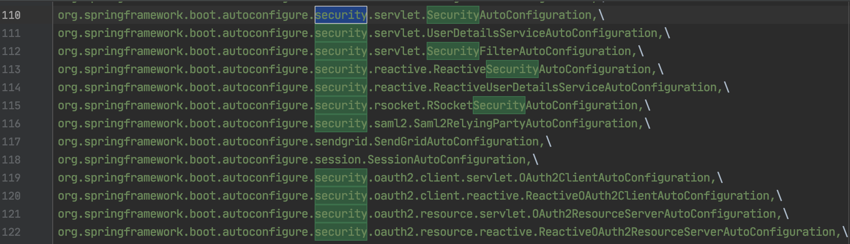
List of Spring Security Auto Configuration

Slide 12
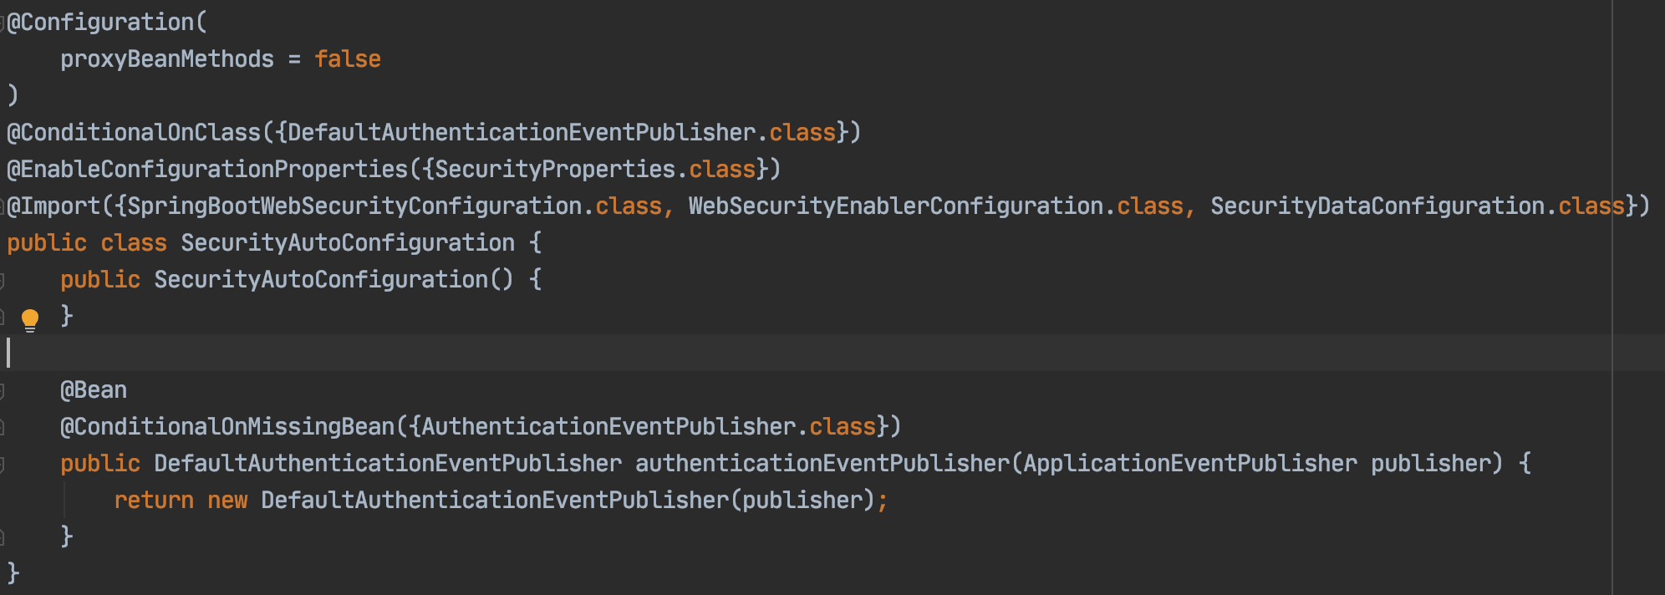
How Spring Security Auto Configuration creates it’s internals (opiniated) by default?

Slide 13
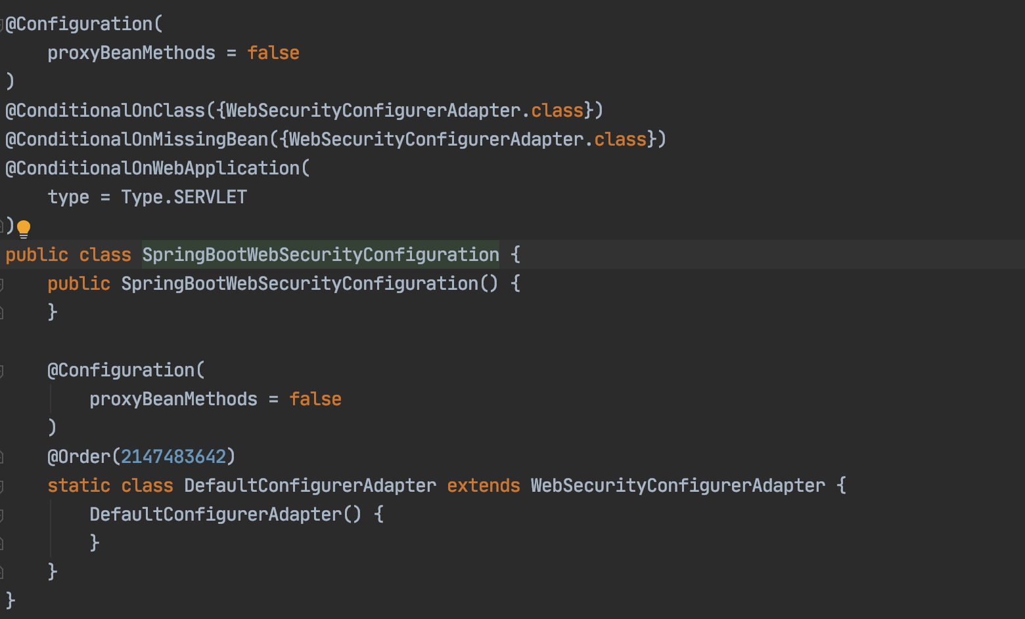
How Spring Security initialize it’s WebSecurityConfiguration by default?

Slide 14
How Spring Boot Security module asks to enter username and password, by default?
WebSecurityConfigurerAdapter #configure()
Supports two types of authentication: FormLogin and HttpBasic
FormLogin: - which contains username and password - submit via POST request
- Uses UsernamePasswordAuthenticationFilter
HttpBasic: - which contains username and password - Header contains Authorization which is of type Basic
Key: Authorization
Value: Basic username:password (base64 encoded)
It’s not a secure
Uses BasicAuthenticationFilter

Slide 15
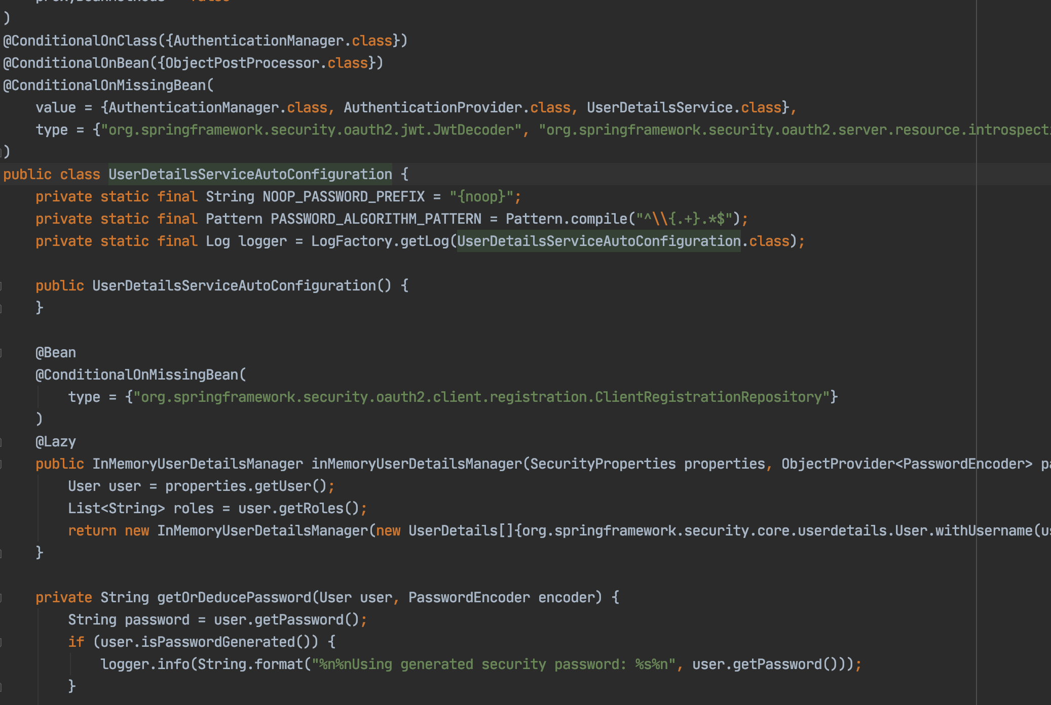
How Spring Boot Security generates default username and password?

Slide 16
HttpBasic Authentication
Browser
Client type a url and hit enter
Server
Server responds with 401 with Header as WWW-authenticate: Basic realm=“..”
Browser prompts a popup to enter username and password
Create header “Autherization=Basic base64(username:password)
Hacker will read your U:P

Slide 17
Digest Authentication
Browser
Client type a url and hit enter
Server
Server responds with 401 with Header as WWW-authenticate: Digest realm=“..” and nonce=“—random number---”
Browser prompts a popup to enter username and password
Create header
“Autherization=Diagest user=“username”
Response= <response-value>
Nonce=<nonce-value>
Server compute digest hash and verify
Redirect to landing url
How to calculate response-value? Hash1: MD5(username:realm:password)
Hash2: MD5(HttpMethod:diagestUri)
Response-value: MD5(Hash1:nonce:Hash2)

Slide 18
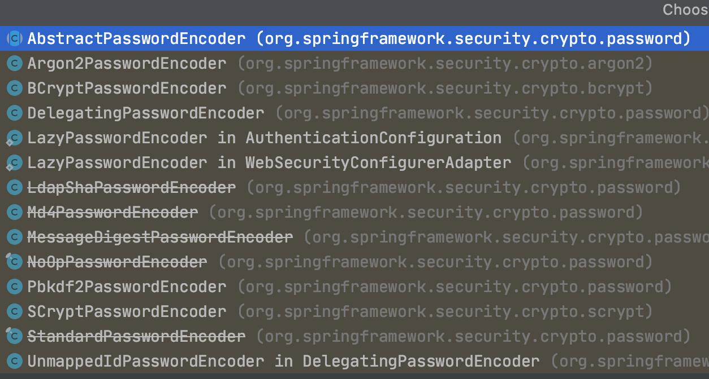
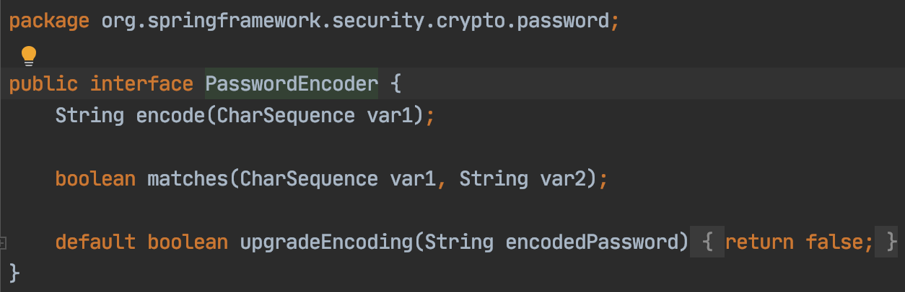
What are the options available for storing password in an encrypted way in Spring Security?

Slide 19
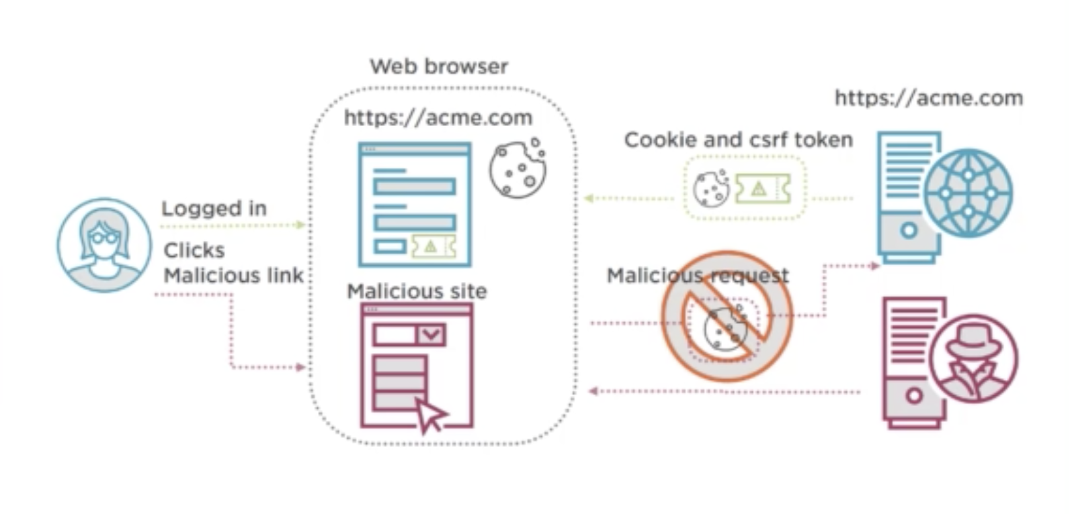
Form Based Authentication
Whenever you submit a Form, server will generate a JSESSION_ID (session). Which is not sufficient. Because, your subsequent
Request will be handled by Malicious site. How to avoid this? You have to enable the CSRF in your server to generate a Cross Site
Request Forgery unique id. Which is recommended for POST and PUT operation. In Spring Security, we have a filter called CsrfFilter.

Slide 20
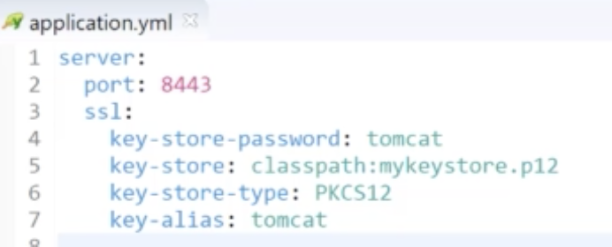
(A) Private Key (A) Public Key
HTTP + SSL = HTTPS
(B) Private Key (B) Public Key
Browser App (A)
1.Enter URL
App Server (B)
SSL Handshake
2.Server sends certificate
3.Browser extract the public key and generate a
Random Session Key + Encrypted Public Key of Server
4.Server decrypt the content using private key & Random session key
5.Henceforth request and response will contain a same Random session key (both encrypt and decrypt)
This is called symmetric encryption
.jks
Java key store
entry
Alias
entry
Private key + certificate
Public key is inside
generate
Certificate
Jdk Keytool
User details

Slide 21
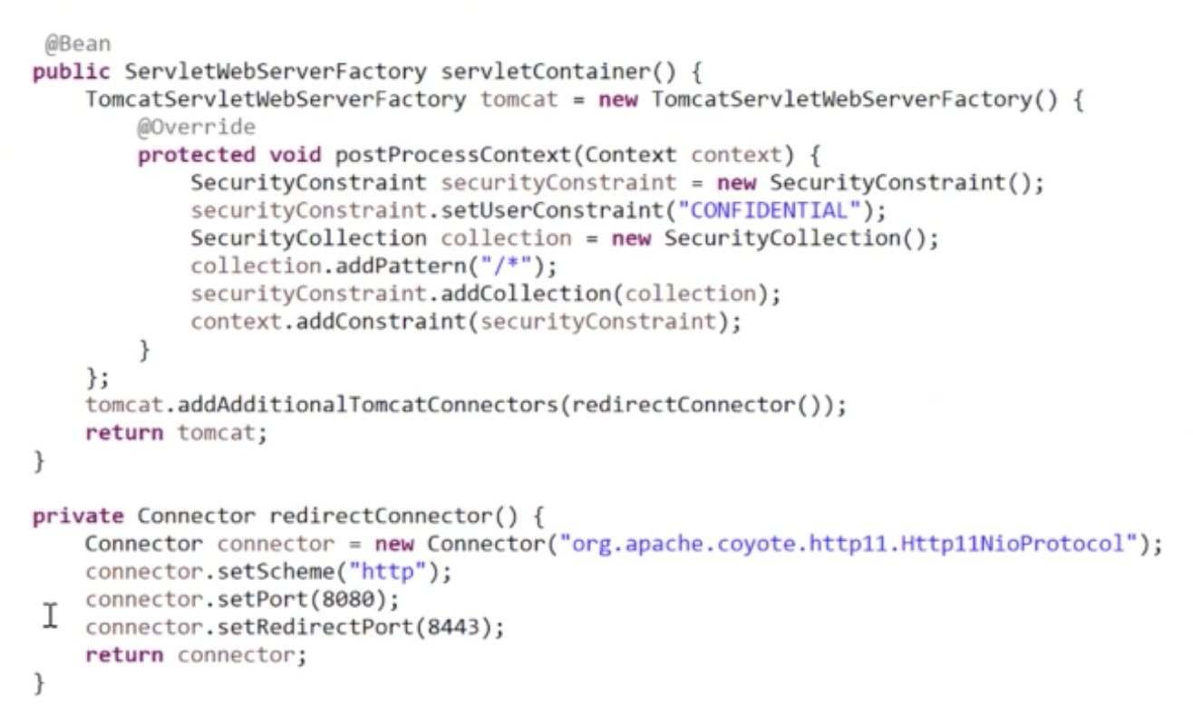
How to redirect to HTTPS when enter HTTP URL in Spring Boot?

Slide 22
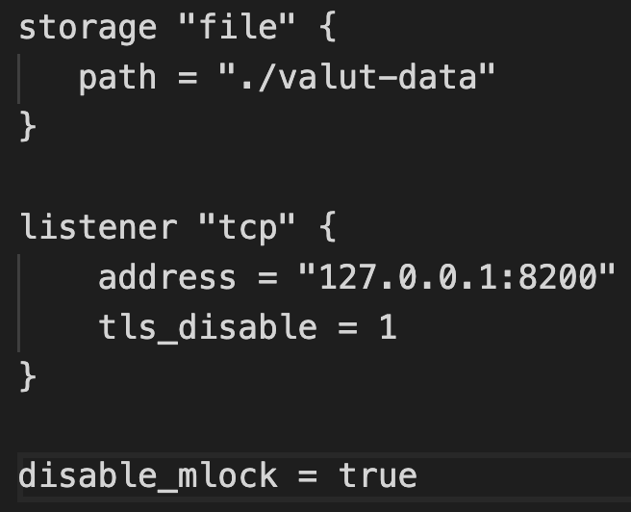
Spring Cloud Vault
How you going to manage your application related secrets in a centralized place and based on the environment? With the
help of Spring Cloud Vault we can achieve this. Spring Cloud Vault which is a module which helps us to externalize the secrets
to a vault server.
Spring Cloud Value uses HasiCorp vault as a server.
How to use HasiCorp?
Navigate to this site https://www.vaultproject.io/ and download the software.
Extract the downloaded zip file
After unzip, you will get an executable file (Unix or windows)
We have to write a configuration file called “vault.hcl” as shown below and placed it inside the folder which contains exe.
Start the vault server. To start the server, use terminal or command “vault server –config ./vault.hcl”
Once the vault server started, we need to initialize for the first time. Use “set VAULT_ADD=http://localhost:8200”
Open another terminal or command and enter "set VAULT_ADD=http://localhost:8200” and “vault operator init”
Cont..

Slide 23
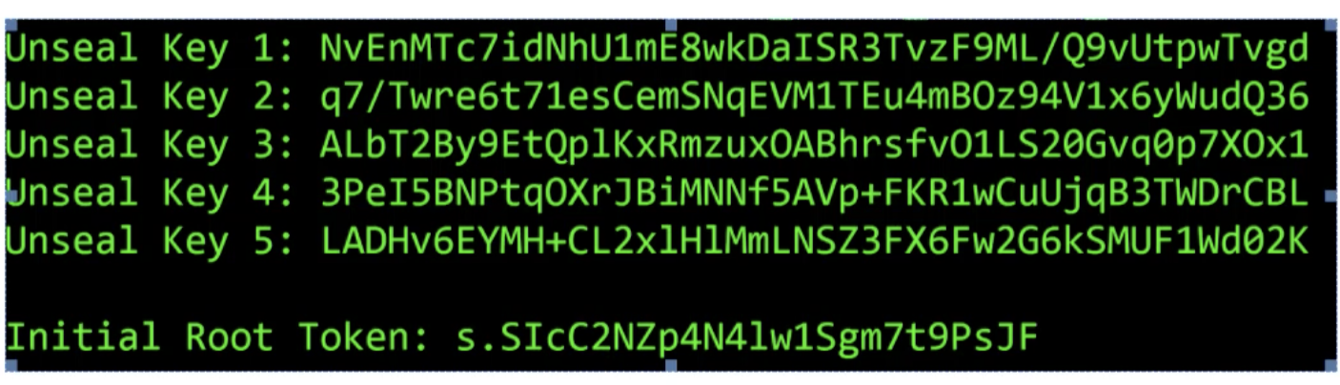
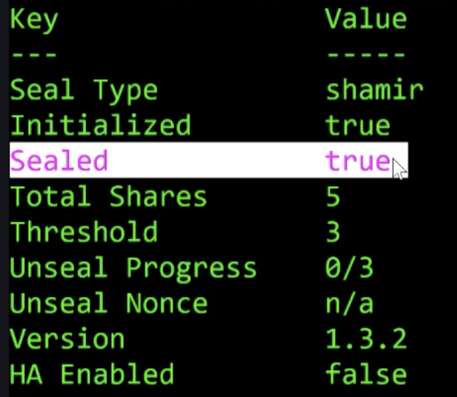
It will produce a 5 unseal key and initial root token as shown below
The first five lines are the master key shares that we will later use to unseal Vault’s storage.
Note: Vault only displays the master key shares only once during initialization. Hence, please copy and keep it someplace.
Execute this command: “set VAULT_TOKEN=<root token value>”
You can check the vault status using: “vault status”.
If vault is “sealed = true” then you can not add any keys. You have to unseal it.
How to unseal? Use any one of the five keys
1: “vault operator unseal <key share 1 value>” 2: “vault operator unseal <key share 2 value>”
3: “vault operator unseal <key share 3 value>”
Cont..

Slide 24
Now you need to enable the KV secrets engine at path secret
Execute the following command: “vault secrets enable -path=secret/ kv”
Now put a key value pair into vault using below command:
vault kv put secret/myapp keystorepassword=tomcat
After the above step, we have successfully stored a key value pair into vault.
Now, it’s a time that how to use this in Spring Boot application:
Add dependency in your POM file
<dependency>
<groupId>org.springframework.cloud</groupId>
<artifactId>spring-cloud-starter-vault-config</artifactId>
<version>3.0.0-SNAPSHOT</version>
</dependency>
Now create a file with name bootstrap.yml under src/main/resources and configure it will following:
spring:
application:
name: myapp
cloud:
vault:
host: localhost
port: 8200
scheme: http
# authentication: token
token: s.yZPi3ogu1BI585ZHw9Dqh2EZ
In application.yml replace the value of server.ssl.key-store-password with ${keystorepassword}

Slide 25

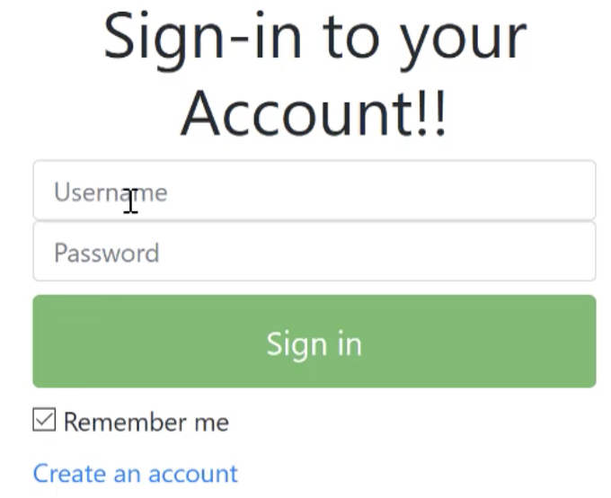
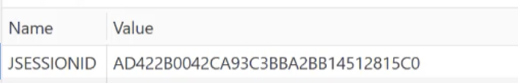
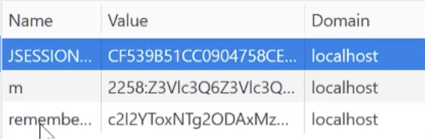
Remember Me
Usually when you login any site and if you would have selected “Remember me” check box, then when you hit the same
Website, it will not ask your username and password. How it’s permits you to enter in to that website? Let see.
Steps:
Add Remember me checkbox in your Login page
In WebSecurityConfiguration enable rememberMe().key(“my-key”) as shown below
http
.authorizeRequests()
.antMatchers("/register","/login","/h2-console/**").permitAll()
.anyRequest().authenticated()
.and()
.formLogin().loginPage("/login").defaultSuccessUrl("/hello", true)
.and().csrf().disable()
.rememberMe().key("my-key");
Hash based Remember Me token use the following formula for generation:
Base64(username:expirationTime:md5Hex(username:expirationTime:password:key))
Session context holder
Session
Remember Me Filter
db
Validate
Before login
remember me
After login
Logout:
and().logout()
.logoutUrl(“/logout”)
.logoutSuccessUrl(“/login”)
.deleteCookies(“remember-me”)

Slide 26

OAUTH 2.0

Slide 27
OAuth is a protocol that allows a user to grant limited access to their resources on one site to another site without having expose their credentials

Slide 28
Google Services
Gmail
LinkedIn.com
Grant Partial
Authorities
Retrieve Info From
Google Services
Resource Owner
(You)
Client
Contacts
Sign In using Google
Photos

Slide 29
What are the ways the resource owner can Grant client?
Authorization Code Grant
Client Credentials Grant Type
Resource Owner Password Grant Type
Implicit Grant

Slide 30







Authorization Code Grant
Google Authorization Server
During Client Registration
Client ID and Client Secret
Redirect URL
Scopes = Permissions
Read Contacts
Read Profile
Register Quora with GAS + Redirect URL
Returns an CLIENT ID and Secret
Quora
6. Save Auth Code
Steps Explanation
8. Request Access token with AuthCode + Client ID + Client Secret
9. Client will get Access Token
10. Using Access Token Quora will request to access my profile
11. Resource Server (Profile) has to validate the token
12. To validate the token, Resource Server send the token to Auth Server to validate
13. Auth Server validate and send the JSON (JWT)
14. Resource Server verifies and send the same to Quora
15. Lets assume Quora is a Spring Security App, it will create a Principle and Authorities using JWT and populate it to Authentication Object and put it in SecurityContext and SecurityContent in Session.
Client
Store AuthCode + Client APP + Scope
2. Redirect to Google Login
3. Submit Credentials to Google
7. Redirect to client with Auth code
4. Google will show the consent page to approve
8. Request Access token
5. Accept the Consent and Scope
Profile
1. Login using Google
Quora
Client
Server
Resource Owner
OAuth Dance

Slide 31
Client Credentials Grant and Resource Owner Password
BookMyShow
BookMyShow.com
Register
Book My Show Auth Server
1
2
5 Login using Username and Password
3 Get Auth Token
Movie Resource
MyApp
4 Call Resource with Access Token
6 Get Booking details
5
MyApp Resources
Theater Resource
MyApp Authentication Server
6
Booking Resource
Booking DB
6
Notes:
1. My App would like to access BookMyShow.com resources. Resources is nothing but REST APIs.
2. In order to access BookMyShow.com resources, MyApp (Client) has to register with BookMyShow’s Authorization server using Client Id and Client Secret.
3. After registered, MyApp would like to access BookMyShow’s secured resources like Movie Resource and Theater Resource. To access the resource, MyApp would connect to BookMyShow’s Auth server to get a token by sending Client Id and Client Secret.
4. Using Access Token call the Movie Resource, this is called Client Credentials Grant
5. Lets assume User is already registered and Now trying to login with his/her username and password which will be validated in MyApp Authentication Server. In this case MyApp should be a trusted app. This is call Resource Owner Password
6. User is using MyApp to book a ticket and those information will be stored in my DB

Slide 32
Design and Develop My Own Auth Server using Spring Security + OAuth2
Scenario 1: Triangle Call (with out JWT)
OAuth Server
1
MyService
3
Other Service
2
Whenever, MyService would like to access OtherService endpoints, it expects a Authentication Token.
MyService will call OAuthServer by supplying ”ClientId”, “ClientSecret” and “GrantType”. Based on this it will generate an OAuth token.
With the generated token when you call a resource on OtherService, it will check that has request contains a token? If Yes,
The OtherService will call Oauth Server to verify the token and get the client details info.
Support there are many calls from MyService to OtherService, and internally OtherService will call OAuth server to get the client details, it will leads to big network traffic.
To avoid this, MyService to OAuth Server get token call will give the token (in this case the token as a type of JWT) which contains information about the user and it’s authorities. Now, with the token, MyService will call OtherService and since it is a JWT token, other service will not call Oauth Server to get the client details. Because, the token itself contains information.

Slide 33

Understand the use of JWT
Sends “Hello” message
Create a “HelloDigiest” by using Private Key of ServiceA
Here Digiest is a Signature of Service A
Receives “Hello” message
Create a “Digiest” by using Public Key of ServiceA
Verify the digest in the request is same with generated? Same, it will allow
Pri A
Pri B
Pub A
Pub B
Pub B
ServiceA
Send “Hello” message
ServiceB
Pub A
“Hello” message tampered by
Unknow app and changed “Test”
“Test” message send to ServiceB
Unknown App
H – Header
P – Pay Load
S – Signature
JWT Token
H
P
S

Slide 34
Design and Develop My Own Auth Server using Spring Security + OAuth2
Scenario 2: With JWT
MyService ← getToken (JWT) → OAuth Server
MyService ← withToken (JWT) → Other Service
Other Service ← → OAuth Server
OAuth Server
1
2
MyService
Other Service
3
4
Whenever, MyService would like to access OtherService endpoints, it expects a Authentication Token.
MyService will call OAuthServer by supplying ”ClientId”, “ClientSecret” and “GrantType”. Based on this it will generate an OAuth token (JWT).
This JWT token contains information about Header + Payload + Signature. Here Signature will be calculated by using Private key of MyService. Payload with be in the encoded form.
Using JWT token, MyService will call OtherService.
OtherService has public key of MyService. OtherService will verify the JWT token Signature part. If Signature matches, then it assumes that Authentication information was fetched from Auth server and it was not tampered.

